Slide 1
Portfolios Diversification and CAPM
Week 9

Slide 2
Asset versus portfolio risk
Scenario | Auto Stock (%) | Gold Stock (%)
E[return] | 2.67 | 3.33
Risk | 1.25 | 17.00
What is the risk and the return of a portfolio formed with 75% auto stock and 25% gold? The correlation between the 2 stocks is -0.891
w
Scenario | Probability | Auto Stock (%) | Gold Stock (%)
Recession | 1/3=0.333 | 1 | 20
Normal | 0.333 | 3 | 10
Boom | 0.333 | 4 | -20

Slide 3
Risk and Return of a Portfolio
To estimate the return and risk of a portfolio you can
Estimate the distribution of returns and then estimate the average (expected return) and standard deviation as for individual stocks
Estimate the average and standard deviation of each stock then:
Covariance

Slide 4
Calculate the expected return – using the distribution of returns
Using the portfolio expected returns (75% Auto & 25% Gold)
Scenario | Probability | Auto Stock (%) | Gold Stock (%)
Recession | 0.33 | 1 | 20
Normal | 0.33 | 3 | 10
Boom | 0.33 | 4 | -20
Portfolio Return (75%A&25%G)
1*.75+20*.25=5.75
3*.75+10*.25=4.75
4*.75+(-20)*.25=-2.00

Slide 5
Calculate the expected return – using the distribution of returns
Using the portfolio expected returns (75% Auto & 25% Gold)
Scenario | Probability | Auto Stock (%) | Gold Stock (%)
Recession | 0.33 | 1 | 20
Normal | 0.33 | 3 | 10
Boom | 0.33 | 4 | -20
Portfolio Return (75%A&25%G)
1*.75+20*.25=5.75
3*.75+10*.25=4.75
4*.75+(-20)*.25=-2.00
Portfolio Return*Prob
0.333*5.75=1.92
0.333*4.75=1.58
0.333*(-2)=-0.67

Slide 6
Calculate the expected return
Using the weighted average of the expected returns of the components.
From last week:
 | Auto Stock (%) | Gold Stock (%)
E[return] | 2.67 | 3.33

Slide 7
Risk and Return of a Portfolio
The portfolio return is the weighted average of the returns of its components

Slide 8
Portfolio Risk
Scenario | Auto Stock (%) | Gold Stock (%)
Recession | 1 | 20
Normal | 3 | 10
Boom | 4 | -20
Using the expected return distribution of the portfolio
Scenario | Prob | Portfolio Return (75%A&25%G)
Recession | 0.33 | 5.75
Normal | 0.33 | 4.75
Boom | 0.33 | -2.00

Slide 9
Portfolio Risk
Scenario | Auto Stock (%) | Gold Stock (%)
Recession | 1 | 20
Normal | 3 | 10
Boom | 4 | -20
Using the expected return distribution of the portfolio
Scenario | Prob | Portfolio Return (75%A&25%G)
Recession | 0.33 | 5.75
Normal | 0.33 | 4.75
Boom | 0.33 | -2.00
(return-E[R])^2 *prob
(5.75-2.83)^2*0.333= 2.84
(4.75-2.83)^2*0.333= 1.22
(-2-2.83)^2*0.333= 7.79

Slide 10
Portfolio Risk using the Correlation
Scenario | Auto Stock (%) | Gold Stock (%)
E[return] | 2.67 | 3.33
Risk | 1.25 | 17.00

Slide 11
Portfolio Risk
Scenario | Auto Stock (%) | Gold Stock (%)
E[return] | 2.67 | 3.33
Risk | 1.25 | 17.00
As long as the correlation between 2 securities is smaller than 1 the standard deviation of the portfolio is smaller than the weighted average of the standard deviation of the securities
Scenario | Auto Stock (%) | Gold Stock (%) | Portfolio 75%Auto& 25&Gold
E[return] | 2.67 | 3.33 | 2.83
Risk | 1.25 | 17.00 | 3.44
E[return] | 0.75*2.67+0.25*3.33 = |  | 2.83

Slide 12
Portfolio Risk
Scenario | Auto Stock (%) | Gold Stock (%)
E[return] | 2.67 | 3.33
Risk | 1.25 | 17.00
As long as the correlation between 2 securities is smaller than 1 the standard deviation of the portfolio is smaller than the weighted average of the standard deviation of the securities
Scenario | Auto Stock (%) | Gold Stock (%) | Portfolio 75%Auto& 25&Gold
E[return] | 2.67 | 3.33 | 2.83
Risk | 1.25 | 17.00 | 3.44
E[return] | 0.75*2.67+0.25*3.33 = |  | 2.83
Risk As Weighted average of Components | 0.75*1.25+0.25*17 = 5.18 THIS IS NOT THE RISK OF THE PORTFOLIO

Slide 13
Risk and Return of a Portfolio
As long as the correlation between 2 securities is smaller than 1; the standard deviation of the portfolio is smaller than the weighted average of the standard deviation of the securities
The portfolio risk is not the weighted average of the risk of the securities

Slide 14
Covariance and Correlation
The interdependence of any two variables is measured by the co-variance or the associated notion of the correlation co-efficient.
The covariance is a (statistical) measure of the tendency of two variables to co-vary.
The correlation coefficient is a measure of the (linear) interdependence of two variables, derived by standardising the covariance. It provides a measure falling on the scale of plus to minus one.
Perfect correlation (ρ=1)– if the returns of the 2 securities move in step together
Perfect negative correlation (ρ= -1)– if the returns of the 2 securities move in opposite directions
Zero correlation (ρ=0)– if the returns of the 2 securities move independently.

Slide 15
Perfect Positive Correlation
RETURNS
Creates no opportunities
for reducing risk
.
Z
X
-d_{x}= -d_{z}
Average outcome
for X and Z
Deviations have the same sign – reinforcing rather than offsetting
Time

Slide 16
Perfect Negative Correlation: Two Assets
RETURNS
Creates opportunity for
reducing risk
X
+d_{x}
Portfolio
Return
-d_{x}
Y
Deviations from the average are offsetting.
Time

Slide 17
Diversification
Diversification Strategy designed to reduce risk by spreading the portfolio across many investments.
Portfolio diversification only works because prices do not move exactly together. (Less than perfectly correlated).

Slide 18
Risk and Diversification
If an investor holds the market portfolio she will only have market risk
Statman, Meir (1987)- around 30 stocks are sufficient for optimal diversification

Slide 19
Market Risk versus Unique Risk
Diversification can reduce the variability of the portfolios. But no matter how many stocks investors hold they can never eliminate all the risk!!
Unique Risk Risk factors affecting only that firm. Also called diversifiable or unsystematic risk.
Market Risk Economy wide (macroeconomic) sources of risk that affect the overall stock market. Also called systematic risk or non-diversifiable.
For a reasonably well-diversified portfolio, only market risk matters!

Slide 20
Total Risk and Market Risk
The SD of an asset is a measure of total risk
Total Risk= Systematic Risk + Unsystematic risk

Slide 21
Risk Aversion
It is common in Finance to assume investors are risk averse
Suppose that you were given £4000 to pay for your living expenses for 1 year. You are also offered the possibility to gamble your money; if you flip a coin and you get heads you double your money if you get tails you loose. Would you do it?

Slide 22
Measuring Market Risk
If we assume that investors are rational and risk averse they will hold well diversified portfolios
The optimal well diversified portfolio is the market portfolio- investors hold portions of the market portfolio
Ftse100; S&P…
For such investors the only important risk is the MARKET RISK of the securities.
This implies that the expected return on an asset depends only on that asset’s market risk.
Market risk depends ONLY on the exposure to macroeconomic events and can be measured as the sensitivity of a stock’s returns to fluctuations in return’s of the market portfolio.

Slide 23
Measuring Market Risk
Beta (β) Measure of market risk. Sensitivity of a stock’s return to the return on the market portfolio.

Slide 24
States of the Economy | Expected Return XYZ | Expected Return MKT
Boom | 2.4% | 1%
Decline | -0.6% | -1%
β=1.5 so if the market goes up by 1% the security goes up y 1.5%

Slide 25
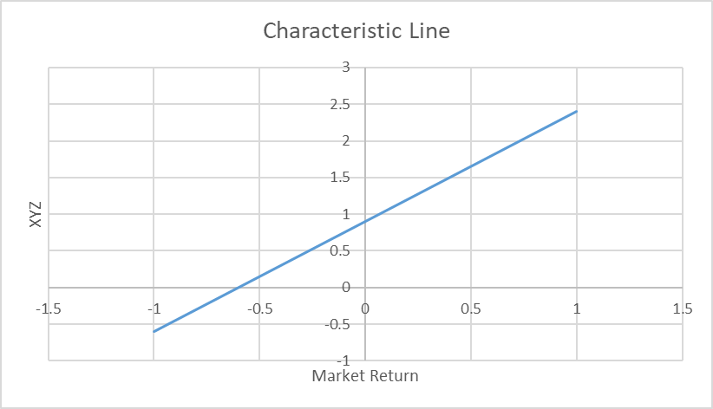
Measuring Beta for XYZ.plc
Slope= β

Slide 26
Beta Formula

Slide 27
Measuring Beta
Aggressive stocks betas greater than 1.
Defensive stocks betas lower than 1.
The market portfolio beta of 1.
A risk free stock beta of 0.

Slide 28
Betas
Stock | Beta
BP | 0.75
Apple | 1.2
Amazon | 1.13
Ford | 1.08
Marks & Spencer | 1.59
Someone that invests on Amazon should expect to earn more on average than someone that invests on BP

Slide 29
Risk and return
We can now establish a relation between expected risk and return
Capital Asset Pricing Model (CAPM) states that the expected return on any security is the risk free returns plus beta times the market risk premium.
Nobel prize of economics in 1990 (William Sharpe,1965; John Lintner,1964)
Note that this is an expectations model (we don’t really know what the future return will be)

Slide 30
What is the expected return of M&S if the risk free rate is expected to be 0.5% and the market return is expected to be 4%

Slide 31
Portfolio Betas
The risk of a portfolio is not the weighted average of the components because some of the total risk can be diversified away
Beta is a measure of market/non diversifiable risk.
The beta of a portfolio is just an average of the betas of the securities in the portfolio weighted by the investment in each security.

Slide 32
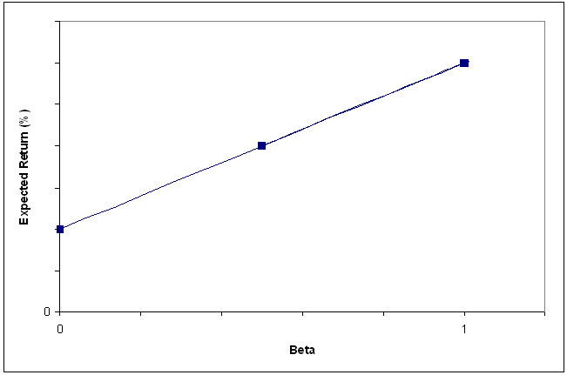
Security Market Line
Underpriced
The CAPM is an equilibrium model
The Security Market Line shows the relationship between the expected return and beta.
Y
overpriced
X

Slide 33
Security Market Line
The security market line describes the expected returns and risks from investing in different securities.
Also sets a standard for other investments. Investors will be willing to hold other investments only if they offer equally good prospects!

Slide 34
Other Risk Measures-Downside Risk
Investors associate risk with “bad” outcomes such as negative returns or returns below expectations. They do not associate risk with large (+) returns or upswings.
Measures of downside risk can be used to estimate required returns and risk-adjusted returns, making them useful to portfolio managers and investors.
*Measuring volatility below a specified benchmark is possible using the “downside standard deviation,” also known as “semi-deviation,” with respect to benchmark

Slide 35
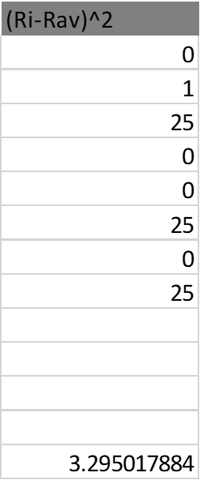
Example in which investors’ target is the historical average of returns
Semi deviation

Slide 36
Coursework Last details

Slide 37
Coursework
Submitted on the VLE (the link is under assessment)
Only 1 submission per group (elect 1 person)
Be sure you submit before the deadline
Check the file you submitted (you can submit many times before the deadline)- you receive an email with a link
Submit the excel spreadsheet used in question 2- YOU NEED TO SUBMIT THE SUBMISSION DOCUMENT AND THE SPREADHEET AT THE SAME TIME
EXPLAIN YOUR CALCULATIONS and TYPE YOUR WORK
DO NOT FORGET THE READING ASSIGNMENTS
Notes:
6th dec

Slide 38
Coursework- No free riding!
If someone from your group did not contribute please let Helena know ASAP and no latter than the end of week 11)!
They will be awarded a mark of 0
Be sure that you did try to contact them and that you have evidence that this is the case

Slide 39
Extra example

Slide 40
Imagine that you won a lottery prize of £100,000 and that you are wondering how to invest the money. You are considering investing 80% of your prize in the market portfolio (you will buy a fund) and the remaining in Treasury Bills. Knowing that the expected market return is 12% and that the return on T-Bills is 4% what will be:
a) The beta of your portfolio?
b) The return on your portfolio?

